Slide 1
Tour And Travel

Slide 2
Table Of Content
Introduction
Problem statement and solution
Modules
Technologies.
Input/Output screen designs

Slide 3

Introduction
We offer tour and travel services including ticket bookings, hotel reservations, rental car services, holiday tour packages, domestic tour packages. We provide the most suitably designed as well as the customized travel packages to the customers. We offer everything related to travelling services under one roof

Slide 4
Problem statement and solution
PROBLEM STATEMENT:
The tour and travel industry faces several challenges, including logistical complexities, customer dissatisfaction, and environmental impact. One of the primary issues is the lack of a seamless and personalized booking experience for travelers, leading to inefficiencies, frustration, and missed opportunities for tour operators.
SOLUTION:
To address these challenges, we propose the development of an integrated tour and travel platform that offers a comprehensive solution for both travelers and tour operators. This platform will leverage technology to streamline the booking process, enhance customer experiences, and promote sustainable tourism practices.

Slide 5
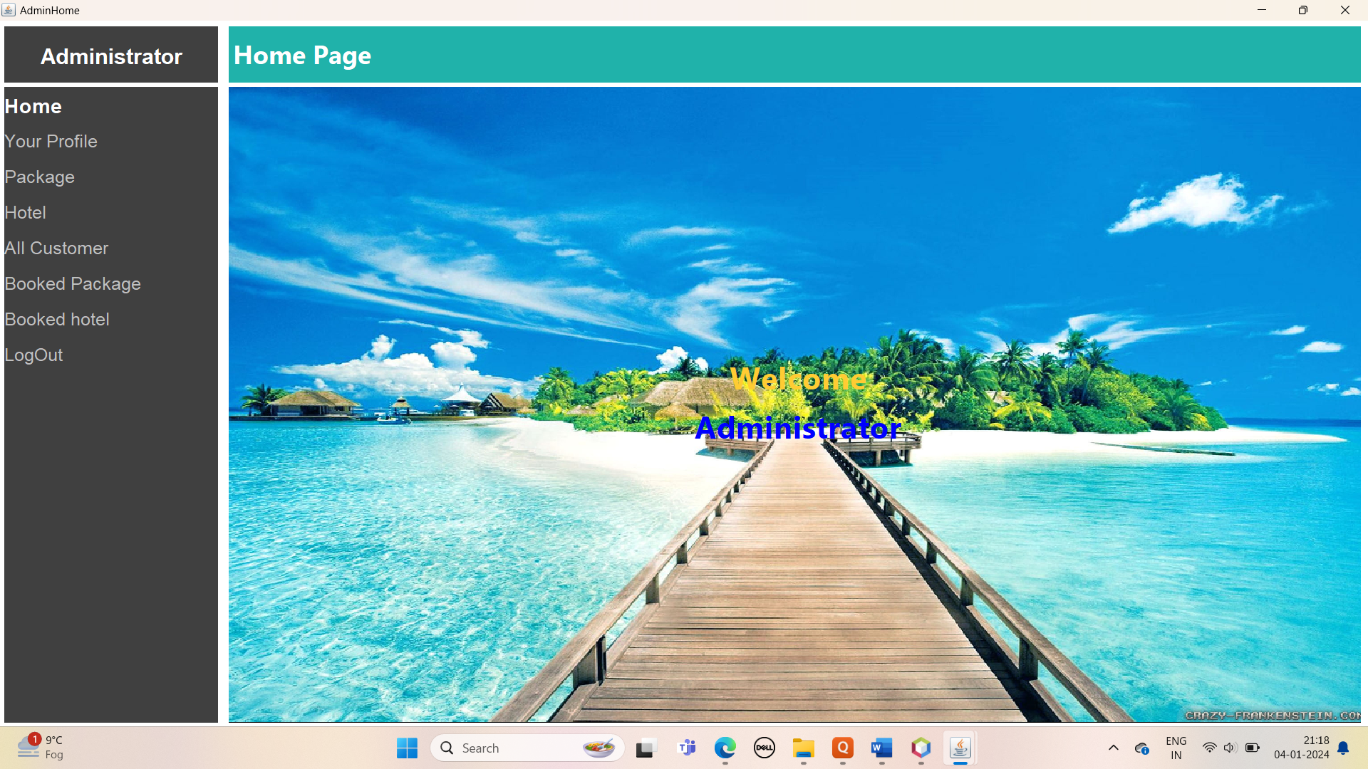
Modules

Slide 6
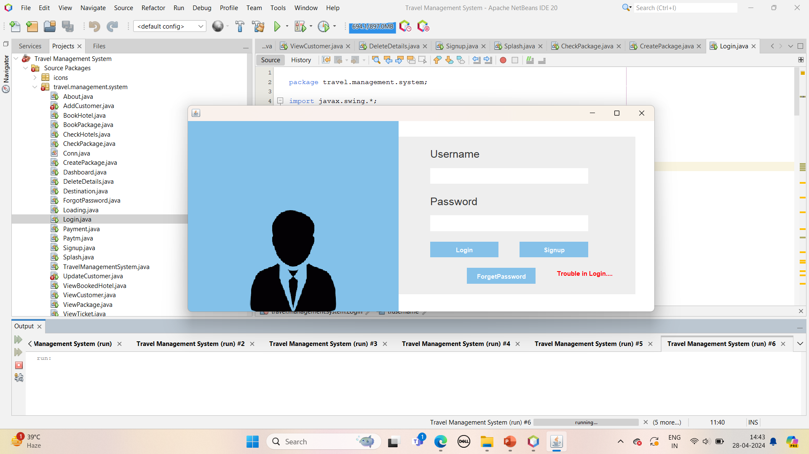
Login Page

Slide 7
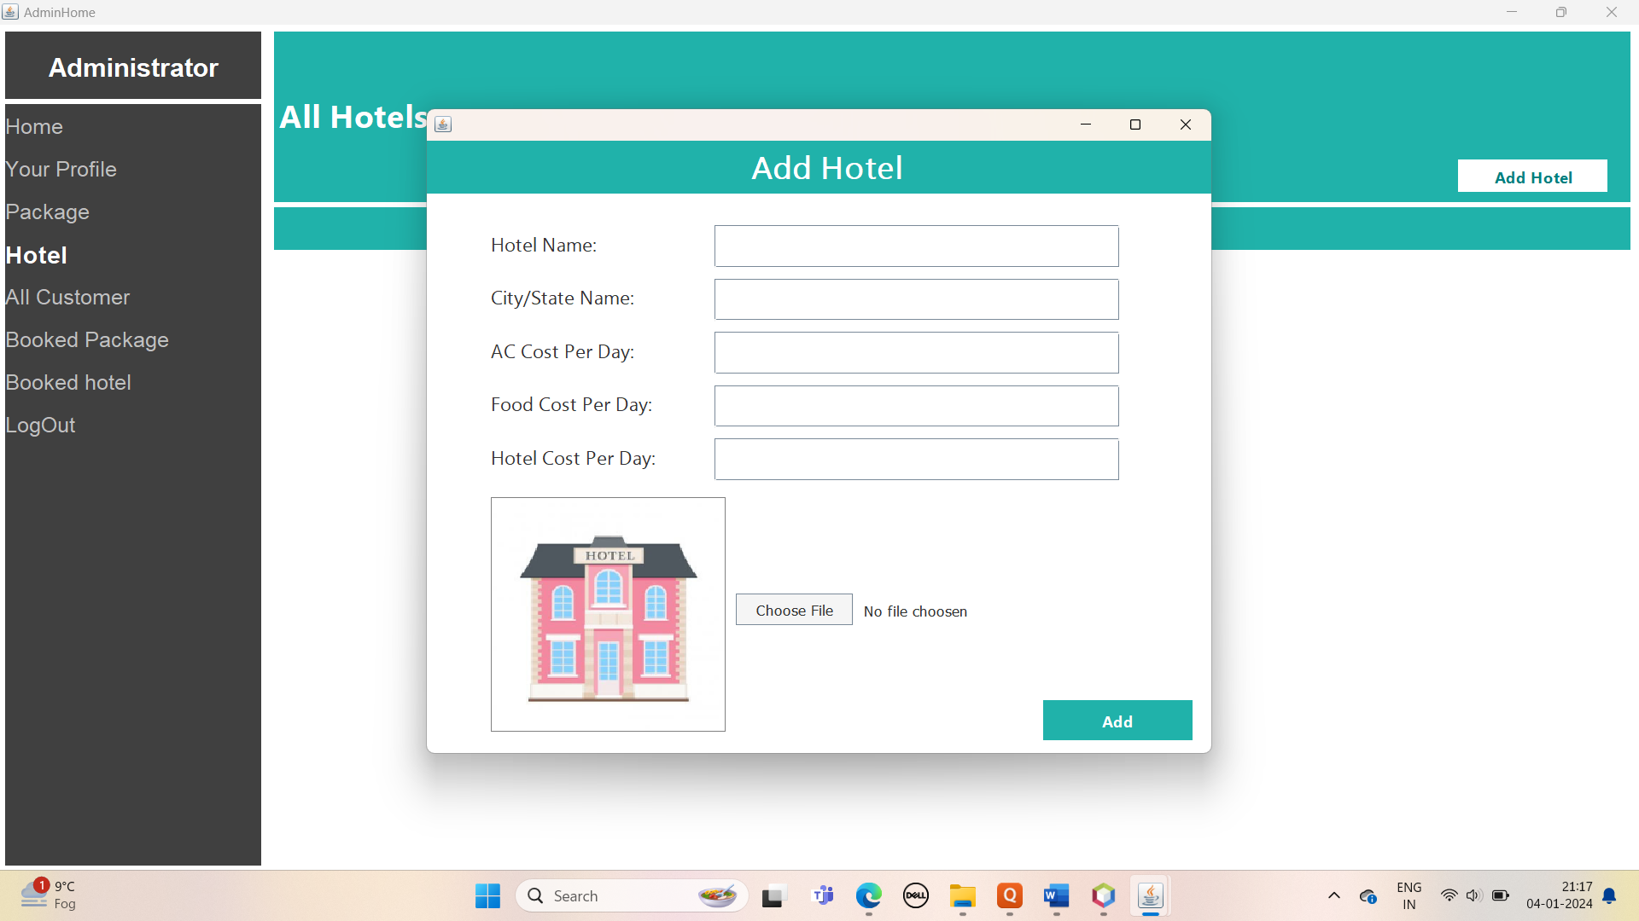
Hotel

Slide 8
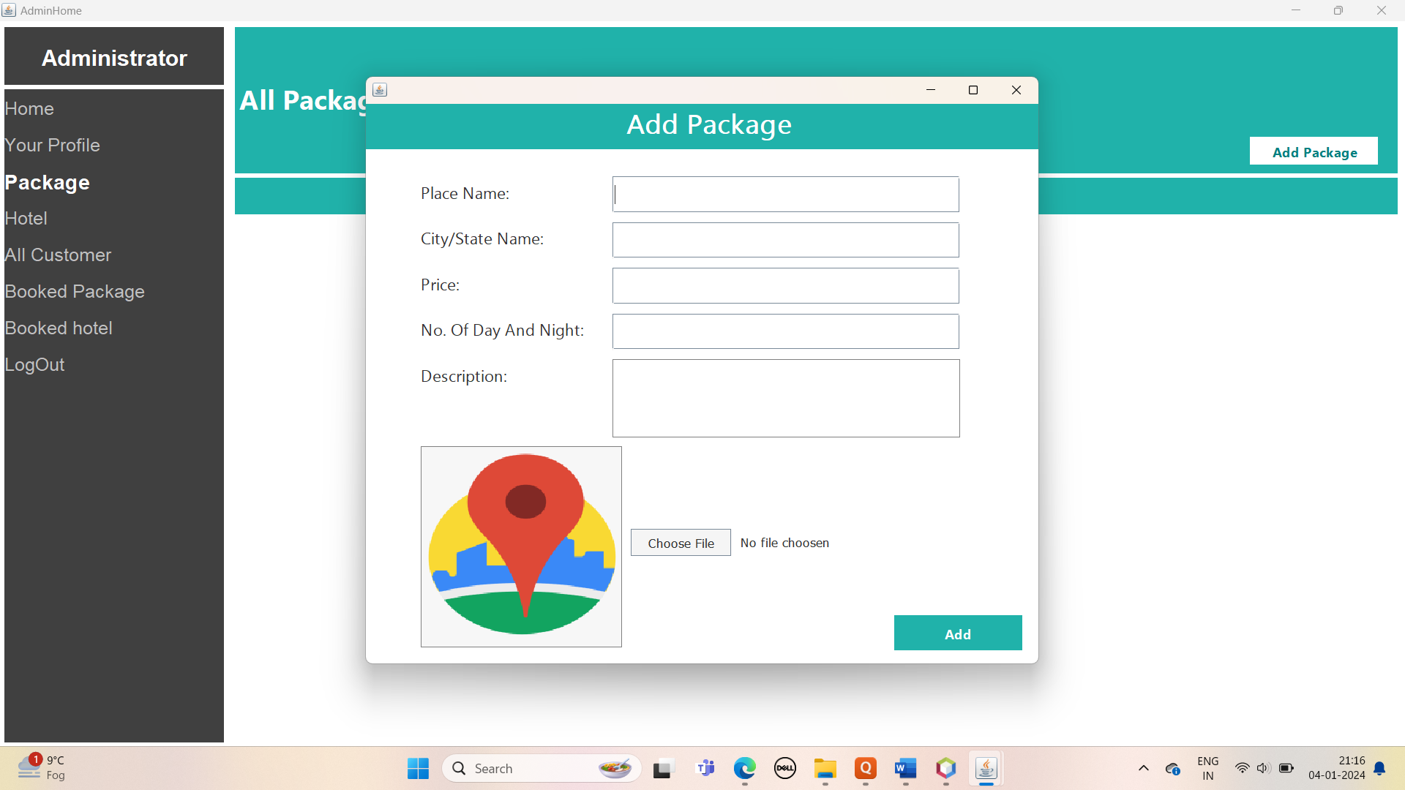
Booked Package

Slide 9
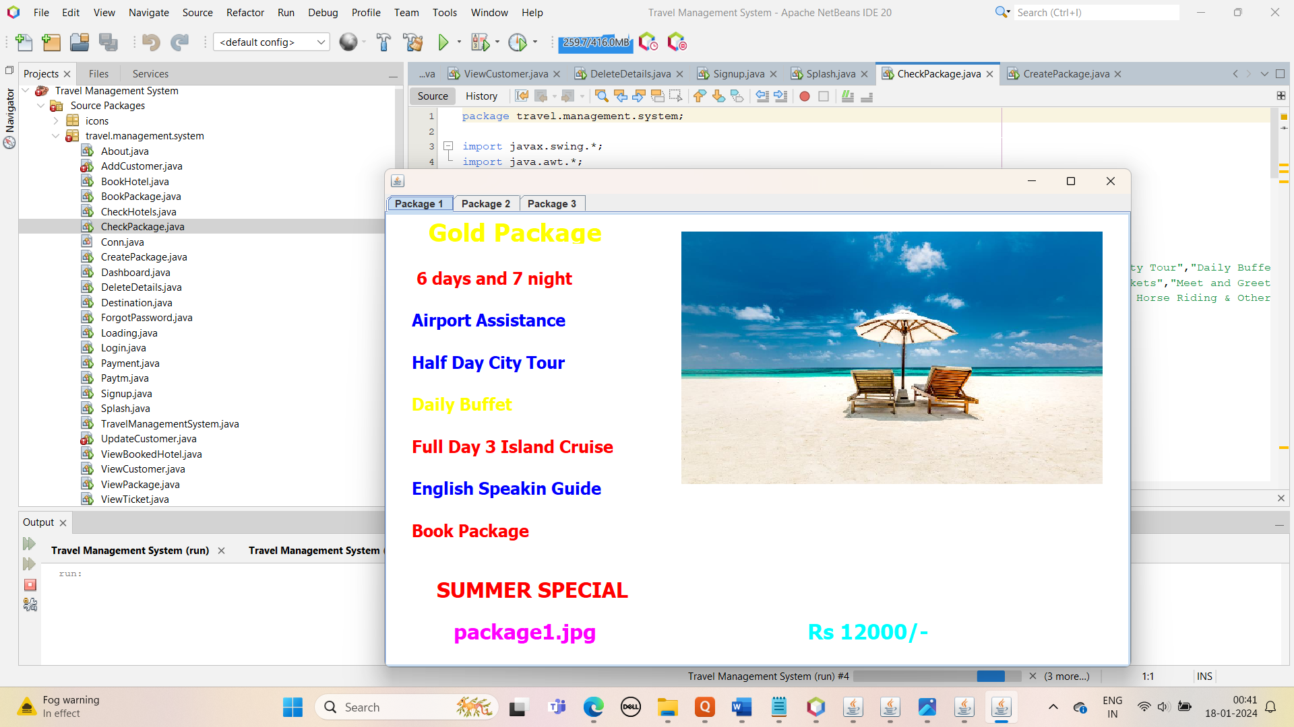
Package

Slide 10
Technologies
Software :
Technologies : Java,Jsp,Servlet
Web Technologies : HTML,CSS,JS
Web Server : Tomcat 8.0
Database : Oracle
JDK Version : JDK 1.5,1.7
Hardware:
Ram : 128MB
Hard disk : 20GB

Slide 11
Thank You

